Slide 1
HackED 2026
Introduction Raspberry Pi RP2040
Steven Knudsen, PhD PEng
knud@ualberta.ca

Slide 2



Slide 3
Outline
RP2040 Overiew
Setting up for MicroPython
Setting up for C/C++
What about Rust?
Wokwi.com and Pico

Slide 4
Sources for the talk
github.com/StevenKnudsen/HackED2026Workshop

Slide 5
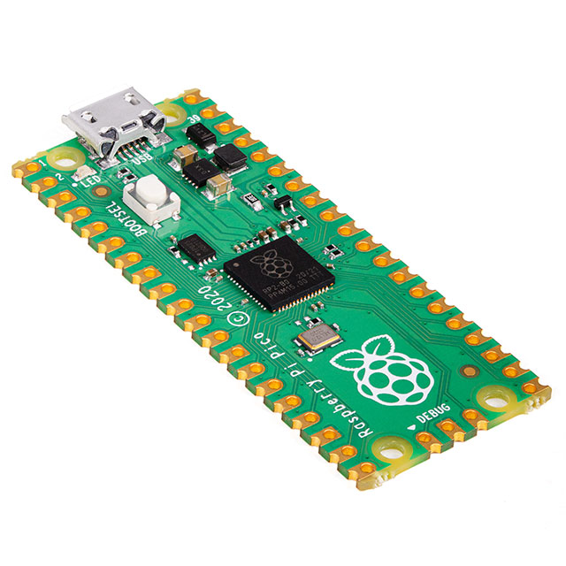
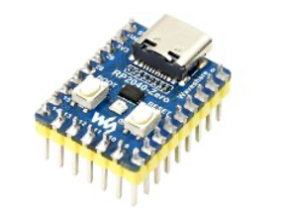
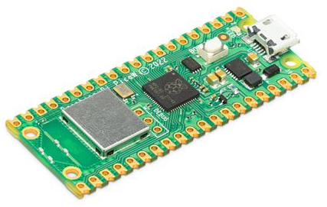
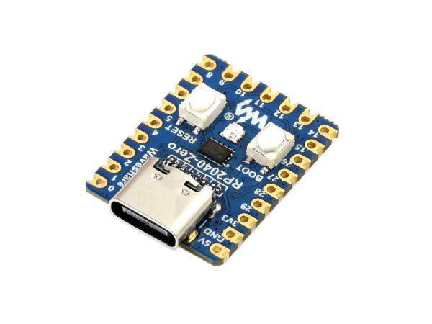
Assumptions
You know how to program in at least one of the languages
Python or C
You have an RP2040-Zero or Raspberry Pi Pico
Images from digikey.ca https://www.waveshare.com/wiki/RP2040-Zero

Slide 6
RP2040 – Raspberry Pi Pico Processor
The RP2040 is the first processor chip designed and manufactured by (probably for) Raspberry Pi Ltd.
It’s a 32-bit dual-core ARM Cortex-M0+ microcontroller
It is very powerful, very inexpensive ($CA1.09 Qty 1)
The dual-cores are clocked at 133 MHz and can be overclocked to 250 MHz
This means under ideal conditions we can get from 266 to 500 million instructions per second (MIPS)

Slide 7
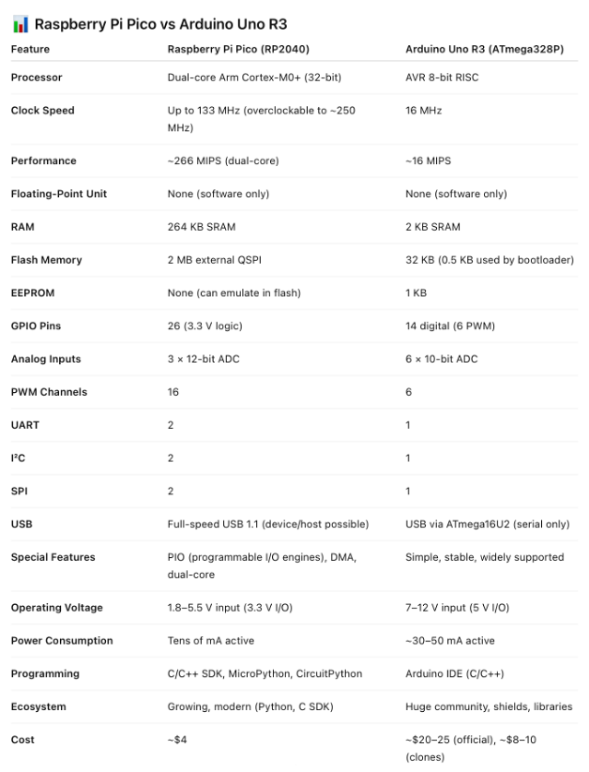
Shameless Plug
In Mechatronics we have selected to base many labs and courses on using the Raspberry Pi Pico
Why?
It is contemporary
Exceptionally capable
Exceptional value
Something you might use in a Mechatronics system

Slide 8
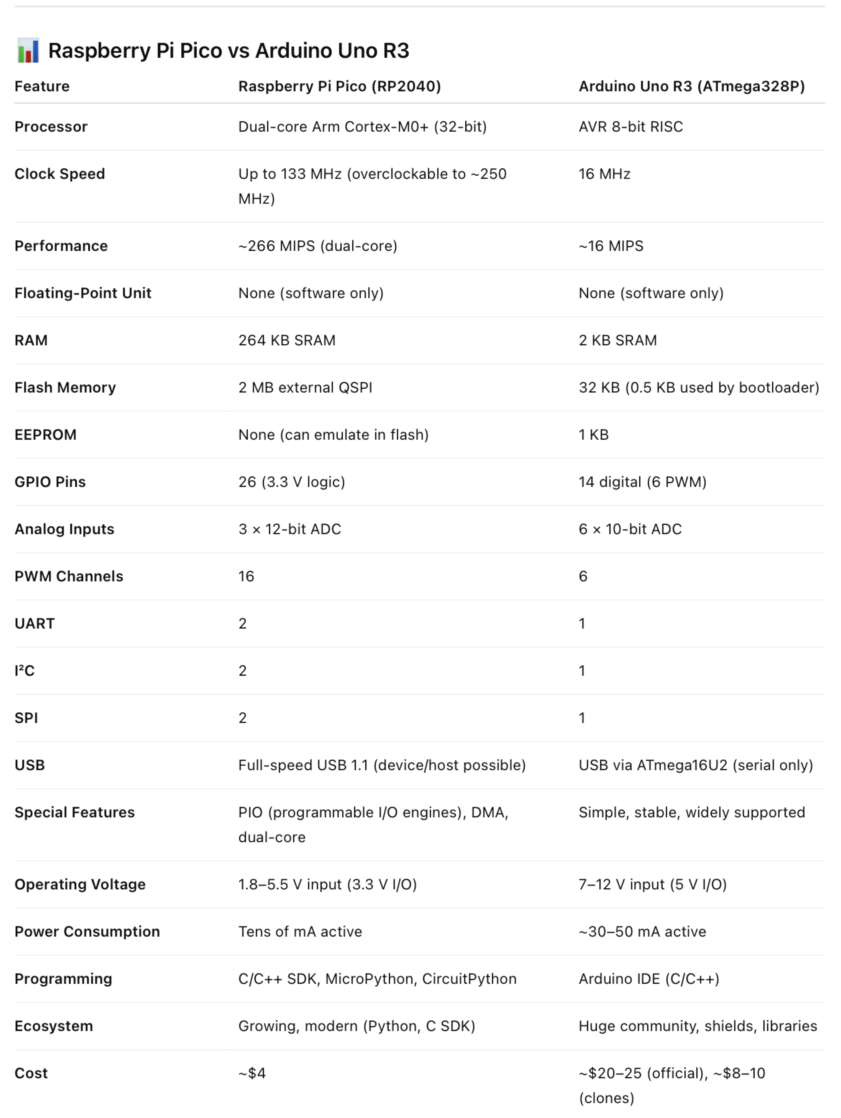
RP2040 vs Arduino

Slide 9
RP2040 vs Arduino

Slide 10
Raspberry Pi Pico and Pico W
Raspberry Pi Pico is a low-cost, high-performance microcontroller board with flexible digital interfaces. Key features include:
RP2040 microcontroller chip designed by Raspberry Pi in the United Kingdom
Dual-core Arm Cortex M0+ processor, flexible clock running up to 133 MHz
264 kB of SRAM, and 2MB of on-board flash memory
USB 1.1 with device and host support
Low-power sleep and dormant modes
Drag-and-drop programming using mass storage over USB
26 × multi-function GPIO pins
2 × SPI, 2 × I2C, 2 × UART, 3 × 12-bit ADC, 16 × controllable PWM channels
Accurate clock and timer on-chip
Temperature sensor
Accelerated floating-point libraries on-chip
8 × Programmable I/O (PIO) state machines for custom peripheral support
Images from digikey.ca

Slide 11
Raspberry Pi Pico and Pico W
$CA5.80 at Mouser.ca $CA8.34 at canada.newark.com
Images from digikey.ca

Slide 12
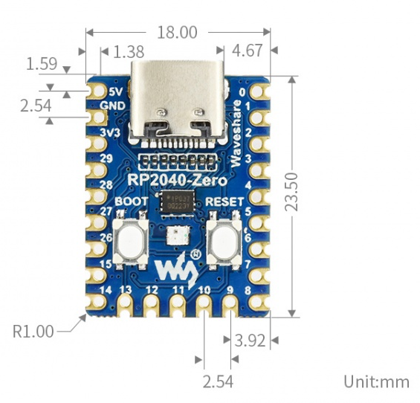
RP2040-Zero
Same processor, a little different form factor
RP2040 microcontroller chip designed by Raspberry Pi in the United Kingdom
Type-C connector; more contemporary, easier to use 26 × multi-function GPIO pins
Castellated module allows soldering directly to carrier boards
29 GPIO pins of RP2040 (20 can be led out through pin headers, the rest can be acccessed by soldering)

Slide 13
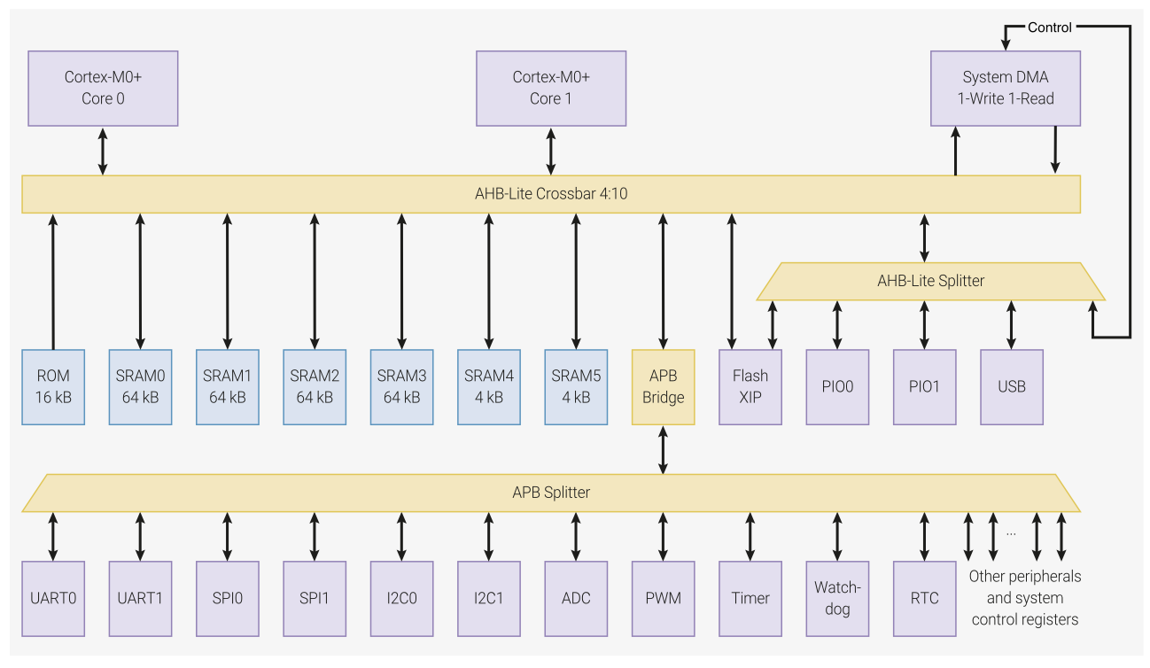
RP2040** Architecture
Advanced high-performance bus matrix (crossbar)
Lots of memory (ROM, SRAM, FLASH)
Lots of peripherals, communications, ADC, Timer, real-time clock (RTC)
** Main reference for the RP2040 material is the RP2040 Datasheet, 2025-02-20

Slide 14
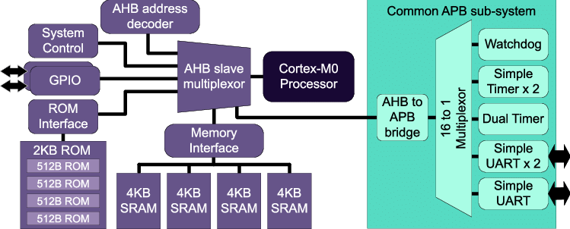
Basic Architecture
Advanced high-performance bus (AHB) matrix

Slide 15
Basic Architecture
Advanced Peripheral Bus (APB)
Read-only Memory (ROM)
Manufacturer-specific program and data to support the processor’s operations, e.g,. specialized embedded devices like analogue-to-digital converters
GPIO – General Purpose Input/Output
Typically control logic levels (signal) on external pins
SRAM – Static Random Access Memory
low-power RAM with fast access
UART – Universal Asynchronous Receiver-Transmitter
Supports serial data communications (send bits on one wire, receive on another)
Timer – Can generate events based on programmed time intervals
Watchdog – Used to monitor the processor or peripherals to make sure they are alive

Slide 16
ARM Cortex-M Family
Cortex- | Description | Examples by ST Micro and Nordic
M0 | is the smallest Cortex-M processor, designed for entry-level microcontrollers. | STMF0, rRF51
M0+ | is a highly energy-efficient processor, specifically useful in wearables for healthcare and fitness. | STM32[C0,G0,L0,U0,WL,WB0,WB]
M3 | has more powerful instruction set, and hence, provides more computation power, specifically useful in smart-home devices. | STM32[F1, F2]
M4 | further includes digital signal processing (DSP) instructions and optional integration of a single-precision floating point unit (FPU). These features make Cortex-M4 useful for mixed signal (analog and digital) and control systems. | STM32[F3,F4,G4,H7,L4,L4+,WL,WB]
M7 | is a high-performance Cortex-M processor, which also supports cache and external memory. Cortex-M7 has the capabilities of a real-time processor, particularly useful for computationally intensive automation applications. | STM32[F7,H7]
M23, M33, and M35P | include TrustZone security, which protects critical information within a system. Cortex-M35P has additional security features to protect confidential data from several forms of physical security attacks. This helps keeping personal information safe in gadgets like smartwatches and home security systems. | STM32[H5,L5,U3,U5,WBA], nRF[91,5340,54, 54H20]
M52, M55, and M85 | processors each implement Helium™ technology that supports vector instructions, making them useful in signal processing and machine-learning applications such as audio processing, power electronics, voice command recognition and still or low frame-rate image processing. | STM32N6

Slide 17
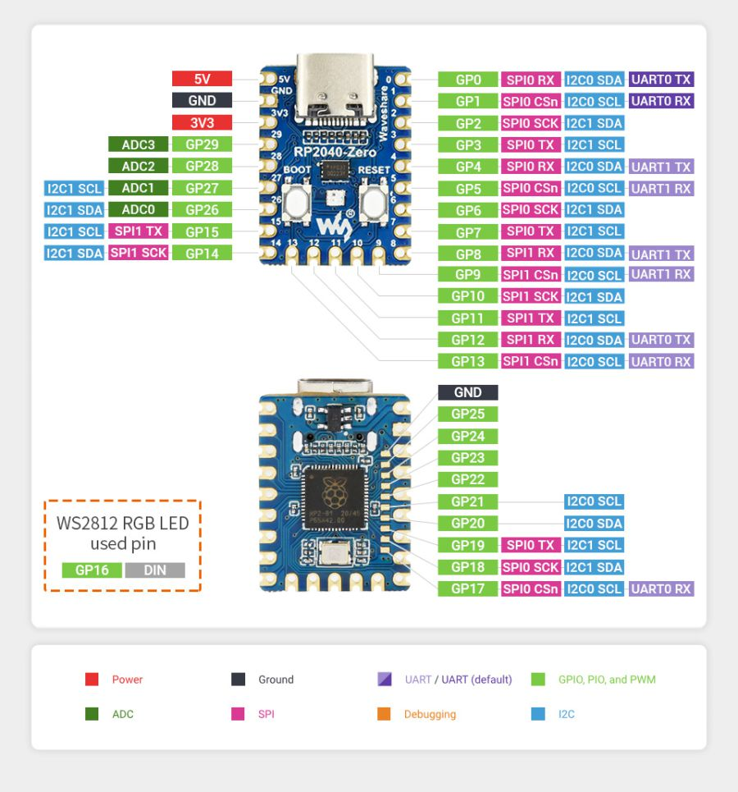
Rp2040-Zero

Slide 18
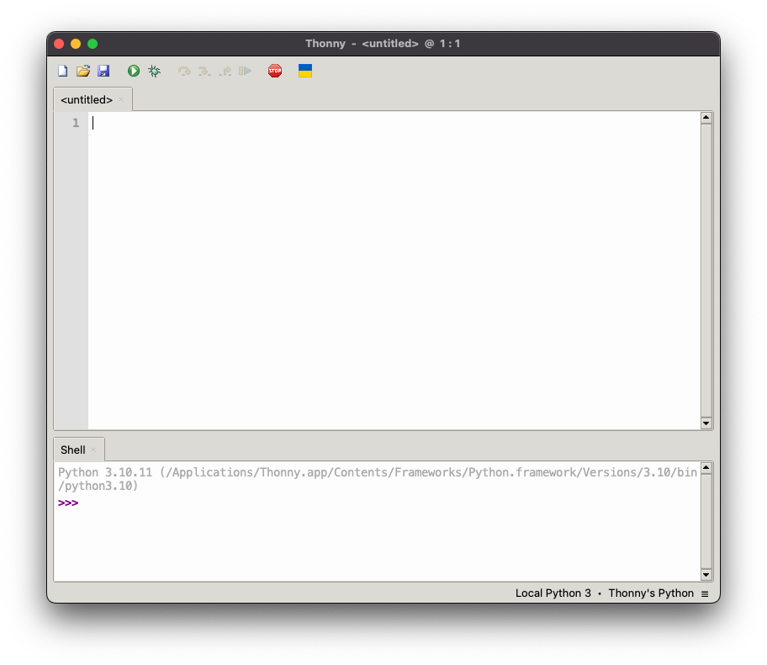
Install Thonny
(Win/Lin/macOS)
Notes:
This is Thonny, a beginner Python IDE. Happens to be running on a MacBook Pro, but same for other OSes

Slide 19
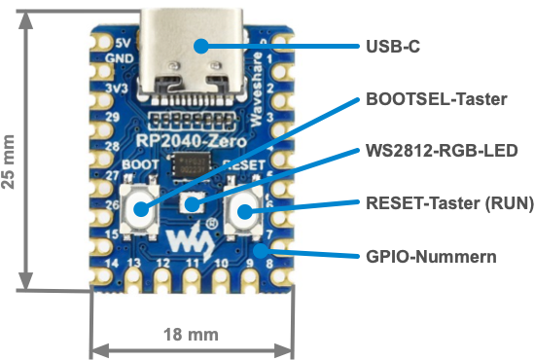
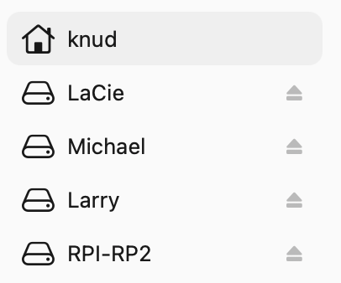
Zero in boot select (bootsel) mode
Plug Zero into USB
Press and hold Boot (select) button
Press and release Reset button
Release Boot button
Open Thonny

Slide 20
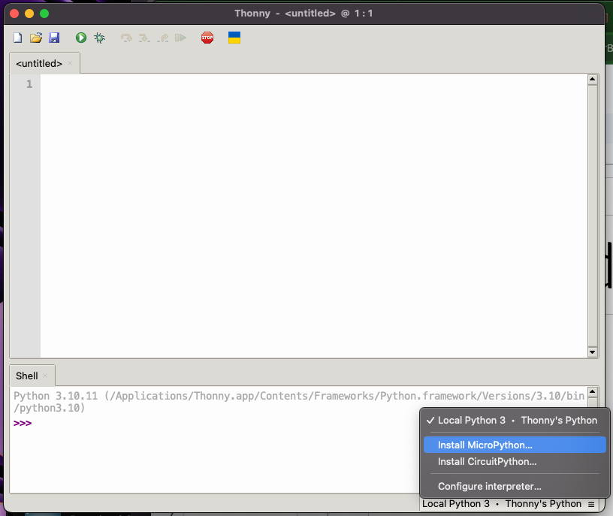
Install
MicroPython
Notes:
Open the hamburger menu in the lower right corner and select install micropython

Slide 21
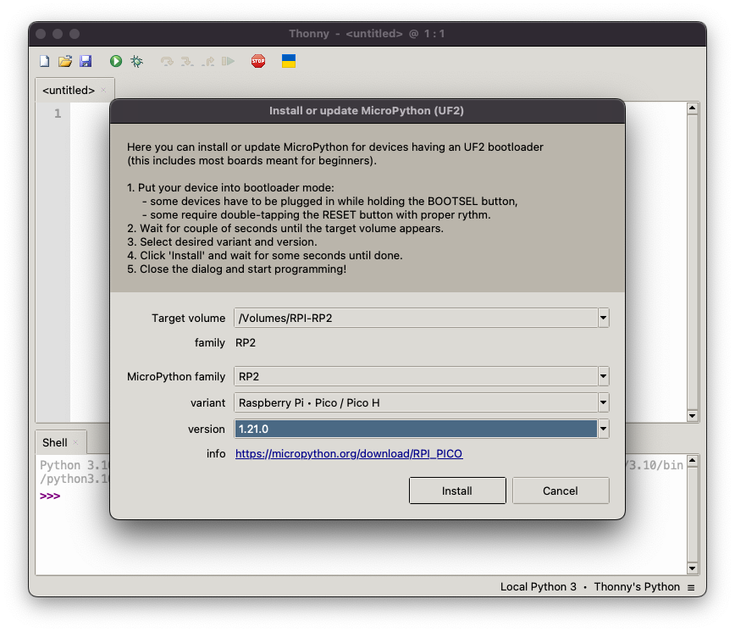
Install dialogue
Notes:
The RPi will disconnect when this is done, then reconnect

Slide 22
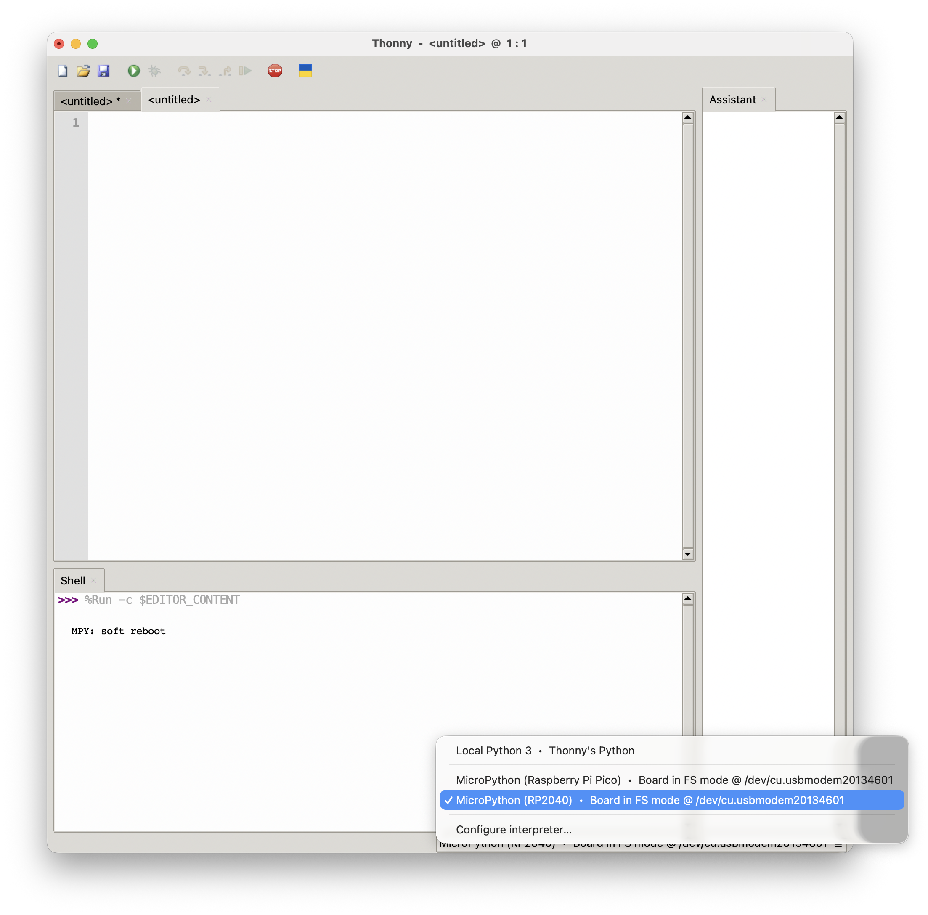
Connect
Notes:
We need to connect to the Pico. Again, open the hamburger menu. Notice these are both really the same, so it doesn’t matter which we choose.

Slide 23
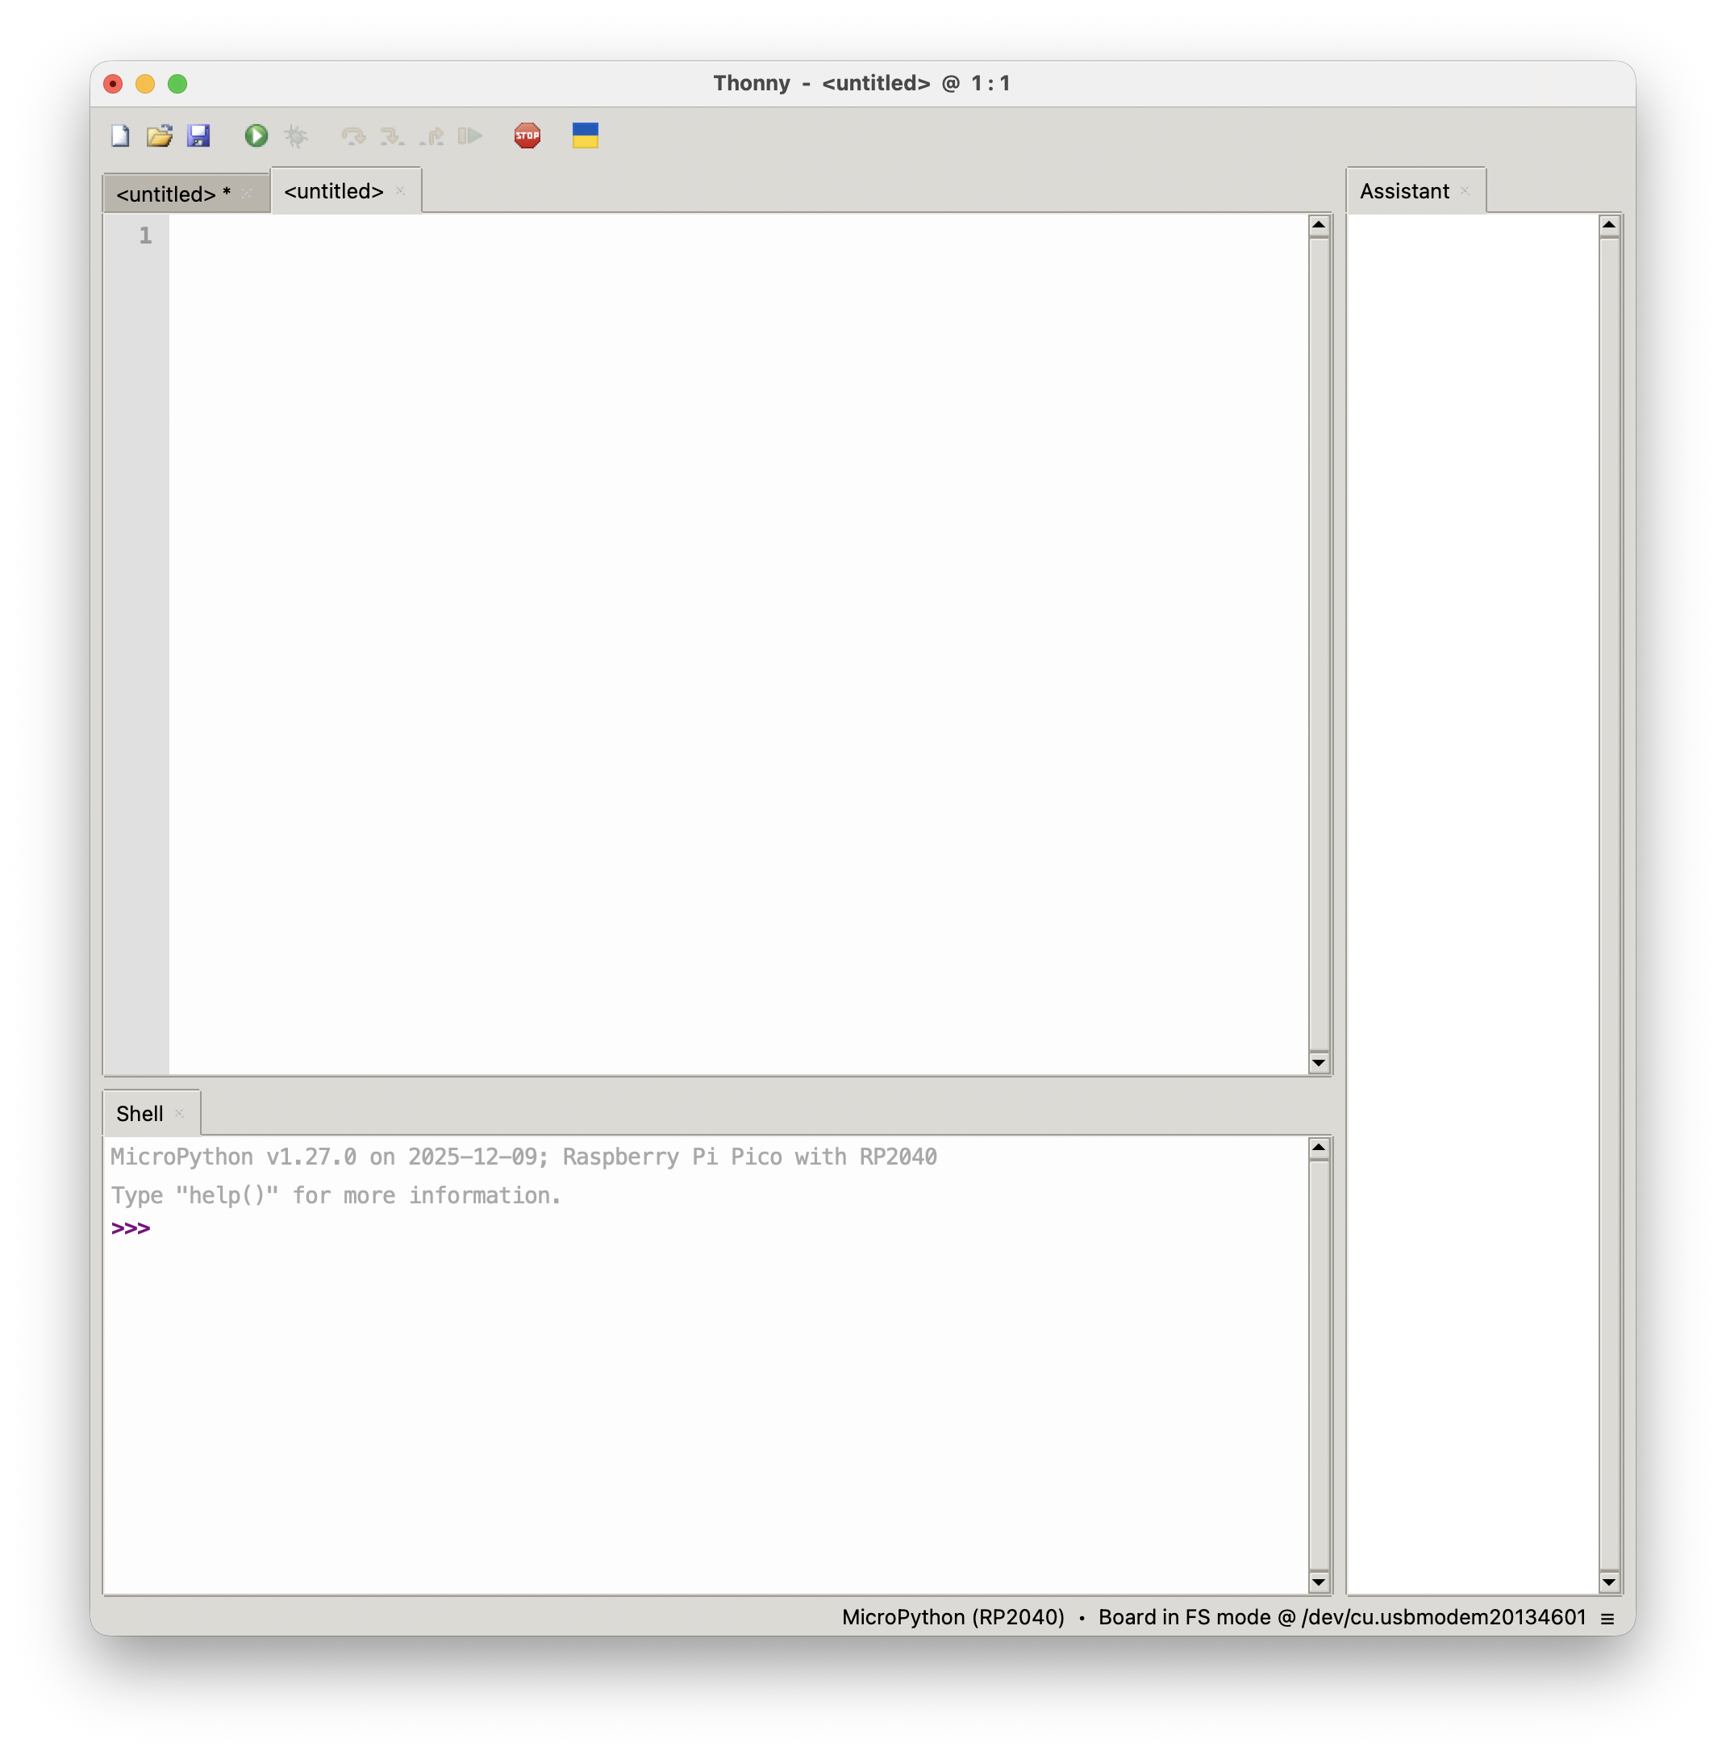

Slide 24
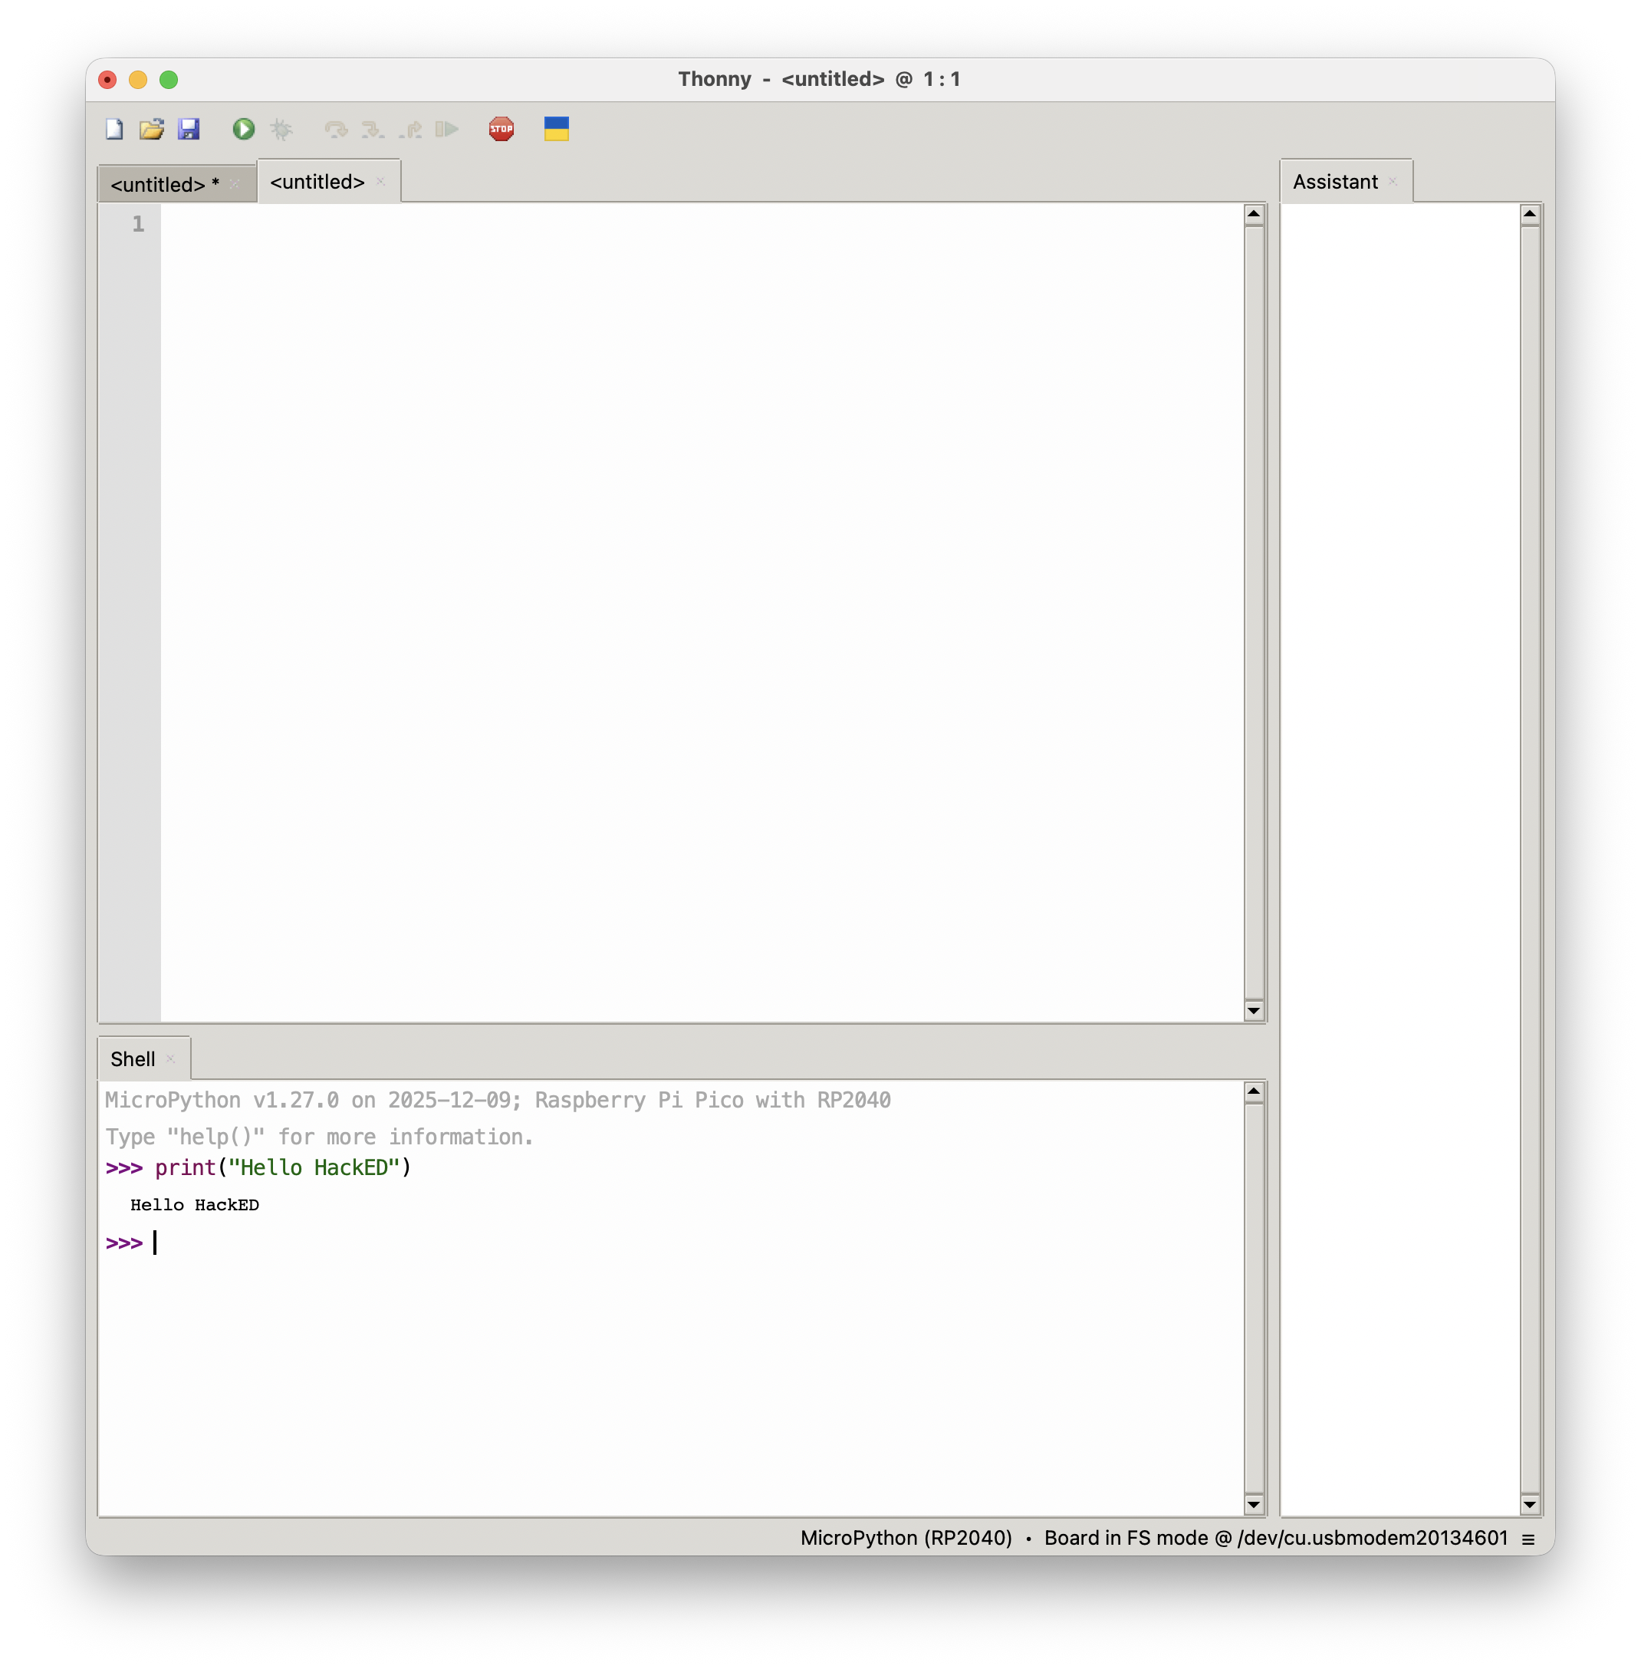
Success!

Slide 25
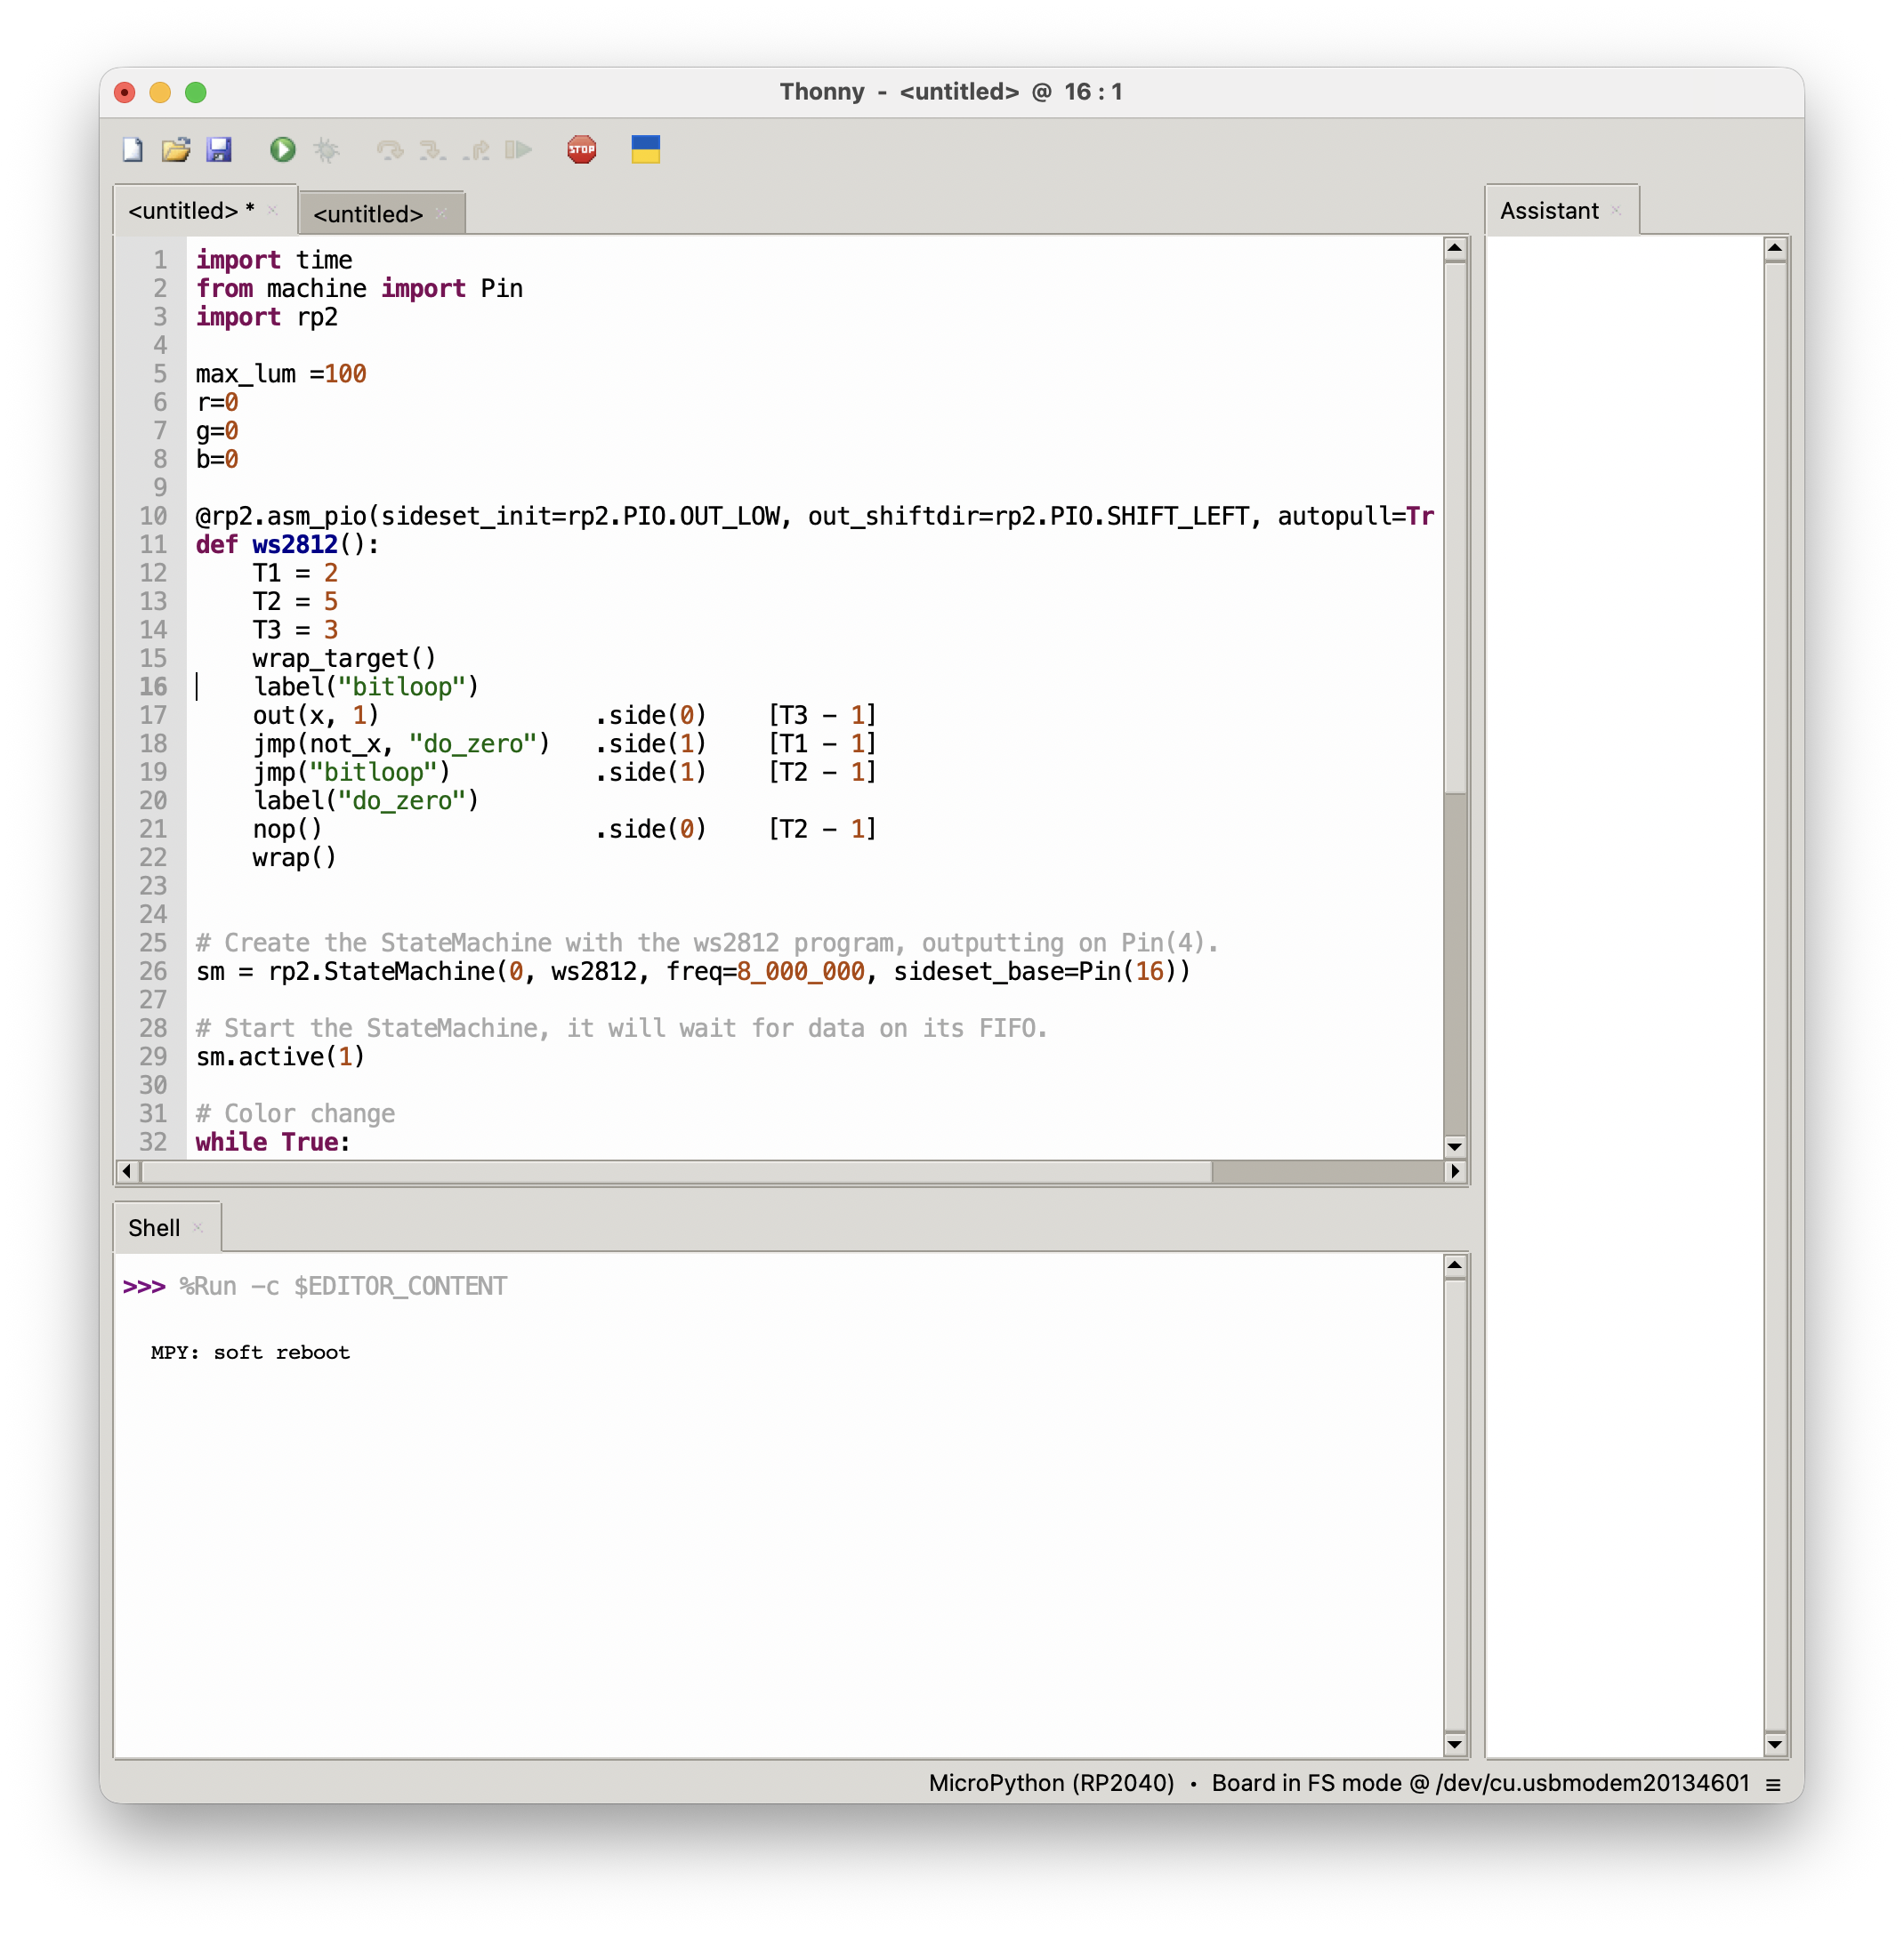
Cycle the RGB in Python

Slide 26

Live demo

Slide 27
GPIOs
Lots of support for GPIO and other peripherals at MicroPython.org
Quick Reference for MicroPython is found at
https://docs.micropython.org/en/latest/rp2/quickref.html
Support for
HW Timers, GPIO, UART, PWM, ADC, SW SPI, HW SPI, SW I2C, HW I2C, I2S, RTC, WDT, OneWire, NeoPixel, APA106
… but probably not …

Slide 28
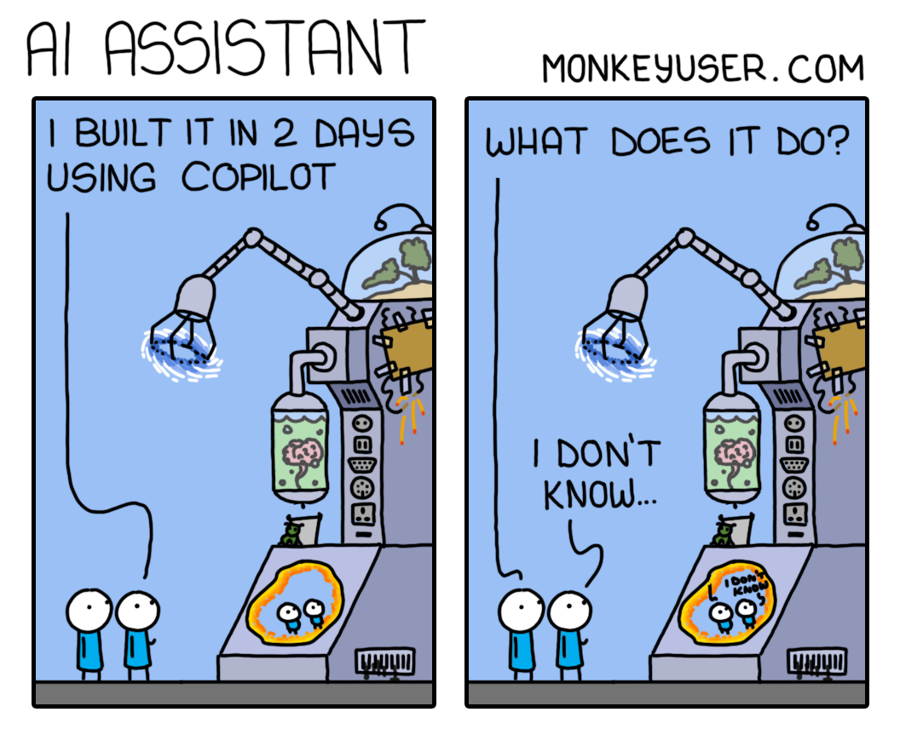
monkeyuser.com

Slide 29
Getting started with the Zero - C/C++
The main reference is the RPi documentation
https://www.raspberrypi.com/documentation/microcontrollers/c_sdk.html
As per that page there are on Github an SDK and Examples repos
Will use Ubuntu 24.04 for the following, but instructions for Win and macOS are on the link above
(Could set up development on a Raspberry Pi, but we won’t for HackEDxx)

Slide 30
Toolchain and SDK install
Need cmake and the GCC ARM toolchain
Make a top-level directory in my Development directory to clone the SDK into
Clone the HackED2026Workshop examples
sudo apt install cmake gcc-arm-none-eabi libnewlib-arm-none-eabi libstdc++-arm-none-eabi-newlib
cd ~Development
mkdir RPi; cd RPi
git clone https://github.com/raspberrypi/pico-sdk.git
git clone https://github.com/StevenKnudsen/HackED2026Workshop.git

Slide 31
RGB example
Let’s make sure the blink example works
The build will take a long time since all the examples will be compiled…
cd ~Development/HackED2026Workshop/C
mkdir build; cd build
cmake ..
make –j4

Slide 32
RGB example
When complete, reset the Zero while holding the boot select button. The Pico will mount as a storage device. Drag and drop ~Development/ HackED2026Workshop/C/build/ RP2040_Zero_Test.uf2 onto the Zero
Will be listed as RPI-RP2 memory device
Drag and drop the uf2 file
The RGB LED should cycle

Slide 33
One more tool – Wokwi.com

Slide 34
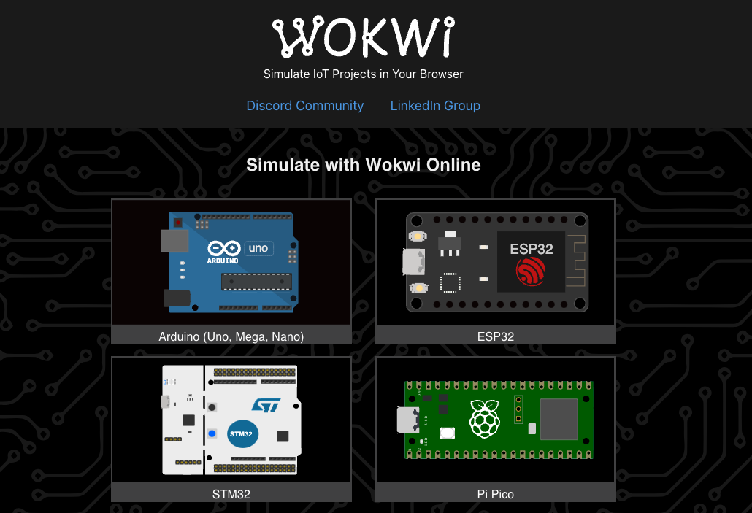

Slide 35
What is Wokwi.com? (from docs.wokwi.com)
Wokwi is an online Electronics simulator. You can use it to simulate Arduino, ESP32, STM32, and many other popular boards, parts and sensors.
Here are some quick examples of things you can make with Wokwi:
Arduino Uno "Hello World"
Blink an LED on ESP32
Monitor the weather on ATtiny85
Control 32 Servos with Arduino Mega
Animate an LED Matrix with FastLED
7 Segment Counter with MicroPython on ESP32
…and Pico!

Slide 36
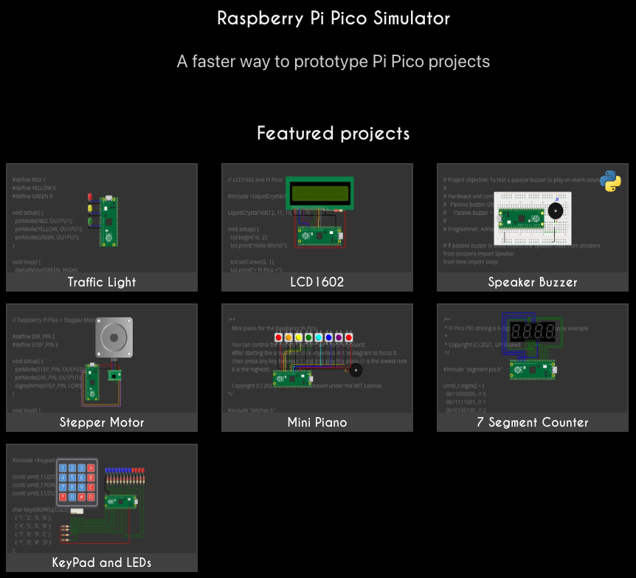

Slide 37
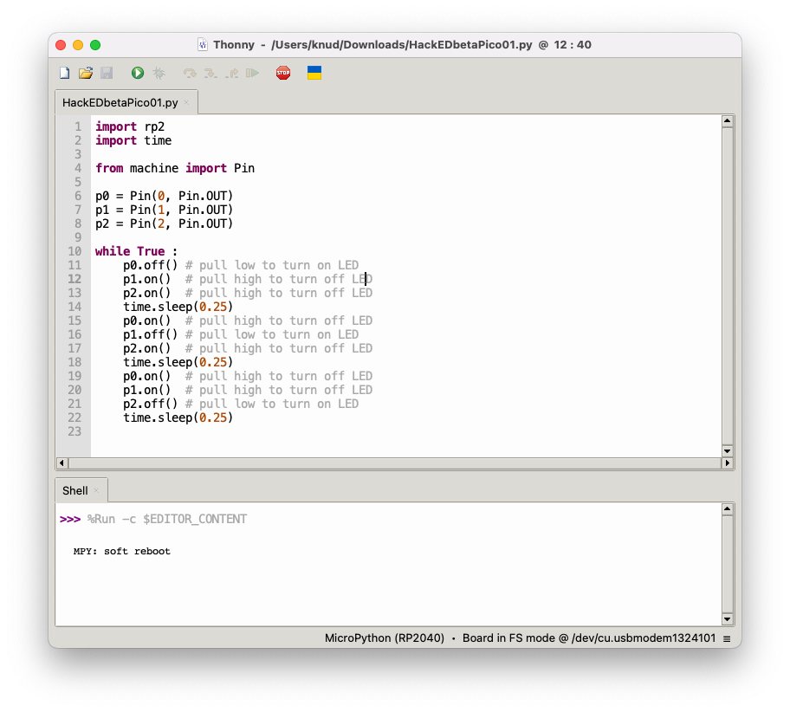
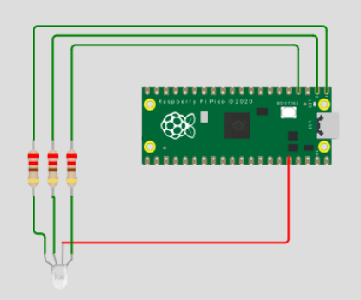
Simple RGB blinky
https://wokwi.com/projects/381422162724423681

